Slide 1
Unit 4
HOW OLD ARE YOU?
Lesson 3

Slide 2
Hoa Mặt Trời
Notes:
Ms Huyền Phạm - 0936.082.789 – YOUTUBE: MsPham. Facebook: Dạy và học cùng công nghệ.

Slide 3
___________ ?
I’m eight years old.
A
B
C
D
What number are you
How old you
How old are you
Who are you
Notes:
Ms Huyền Phạm - 0936.082.789 – YOUTUBE: MsPham. Facebook: Dạy và học cùng công nghệ.

Slide 4
How old _____ ?
I’m seven years old.
A
B
C
D
Am I
Are you
Is this
Is that
Notes:
Ms Huyền Phạm - 0936.082.789 – YOUTUBE: MsPham. Facebook: Dạy và học cùng công nghệ.

Slide 5
How old are you ?
I’m six _______.
A
B
C
D
year old
old
years
years old
Notes:
Ms Huyền Phạm - 0936.082.789 – YOUTUBE: MsPham. Facebook: Dạy và học cùng công nghệ.

Slide 6
How old is Mai?
A
B
C
D
She is five years old.
He is five years old.
I’m five years old.
I am five years old.
Notes:
Ms Huyền Phạm - 0936.082.789 – YOUTUBE: MsPham. Facebook: Dạy và học cùng công nghệ.

Slide 7
How old is she ?
She is nine years old.
A
B
C
D
2
9
8
6
Notes:
Ms Huyền Phạm - 0936.082.789 – YOUTUBE: MsPham. Facebook: Dạy và học cùng công nghệ.

Slide 8
___ are you?
I’m nine years old.
A
B
C
D
How old
What
Who
How
Notes:
Ms Huyền Phạm - 0936.082.789 – YOUTUBE: MsPham. Facebook: Dạy và học cùng công nghệ.

Slide 9
How old is he? ____ four years old.
A
B
C
D
I am
She is
He is
You are
Notes:
Ms Huyền Phạm - 0936.082.789 – YOUTUBE: MsPham. Facebook: Dạy và học cùng công nghệ.

Slide 10
How old is Quan?
He is ten years old.
A
B
C
D
3
4
7
10
Notes:
Ms Huyền Phạm - 0936.082.789 – YOUTUBE: MsPham. Facebook: Dạy và học cùng công nghệ.

Slide 11
Notes:
Ms Huyền Phạm - 0936.082.789 – YOUTUBE: MsPham. Facebook: Dạy và học cùng công nghệ.

Slide 12
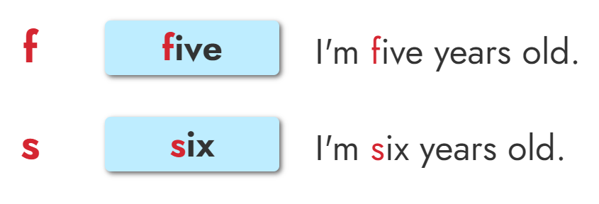
1. Listen and repeat

Slide 13
2. Listen and write.
1. I’m _________ years old.
2. I'm _________ years old.
five
six

Slide 14
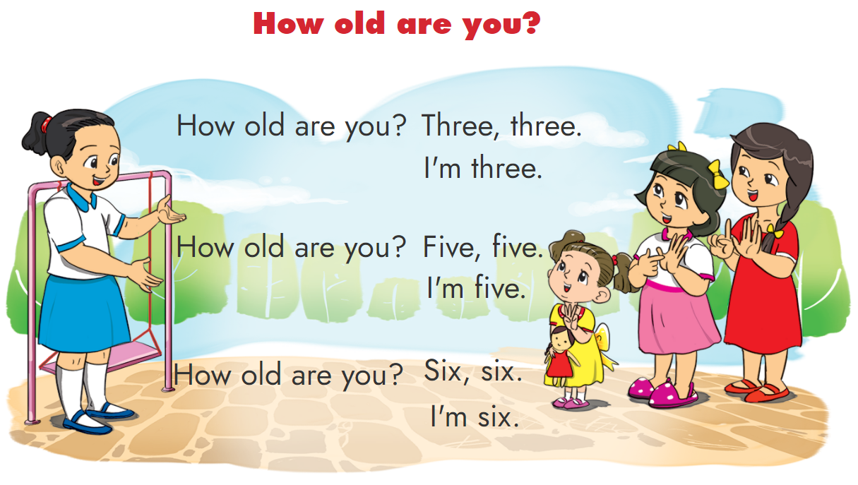
3. Let’s chant

Slide 15
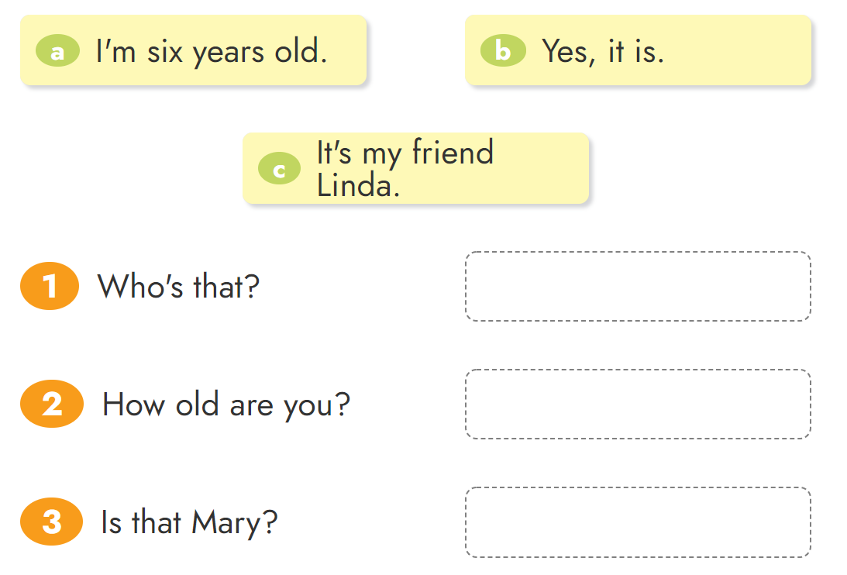
4. Read and match.

Slide 16
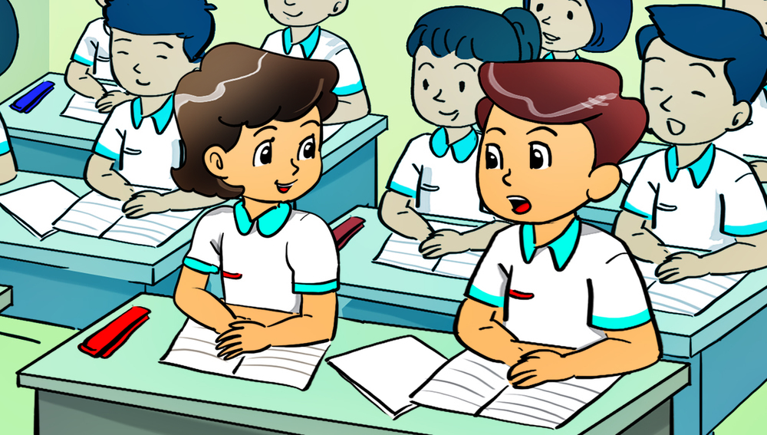
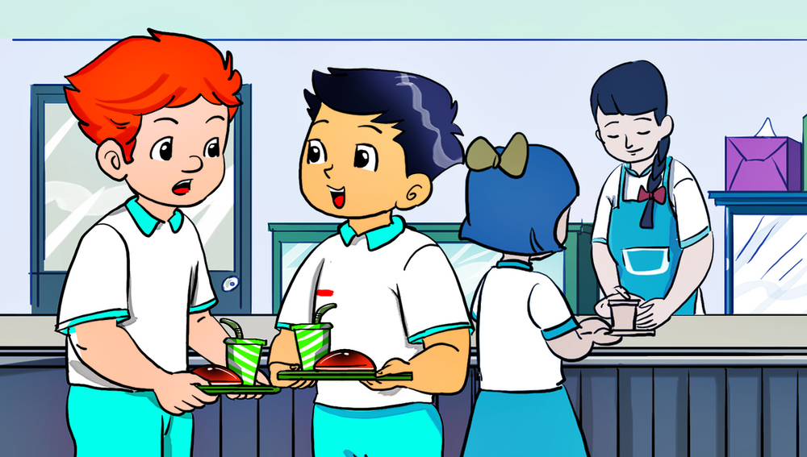
5. Read and write
1. Hoa: ______ are you, Nam?
Nam: _____ eight years old.
2. Tony: ______ are you, Quan?
Quan: ______ ten ________.
How old
How old
I’m
I’m
years old

Slide 17
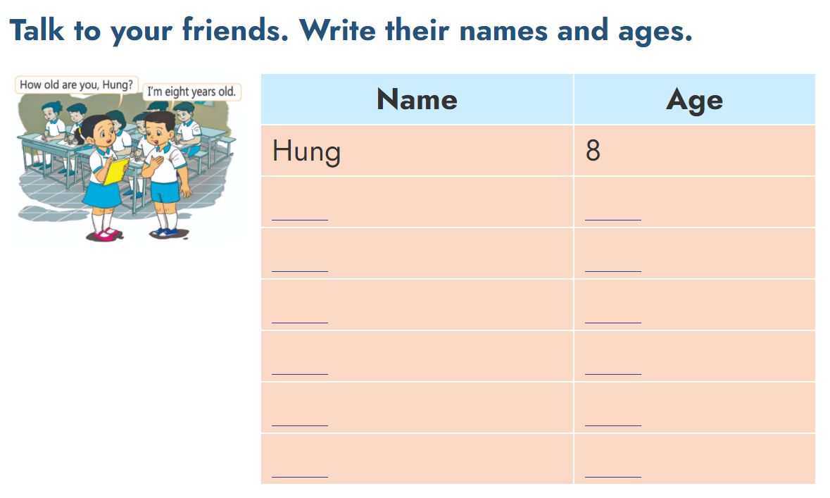
6. Project

Slide 18
THANK YOU!
Welcome to join with me!

